Slide 1

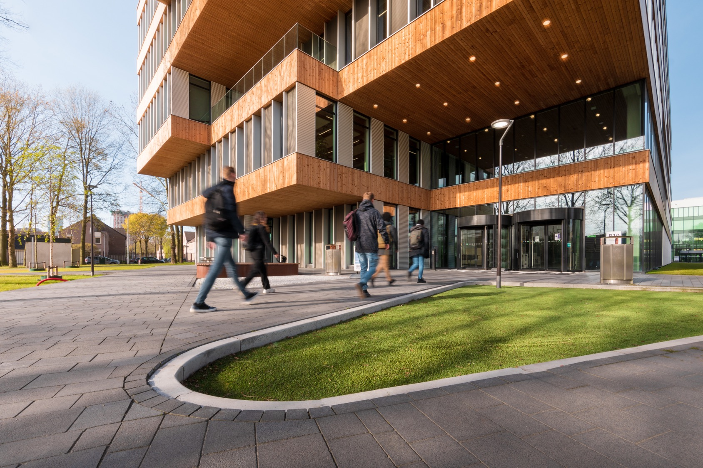

IT Business Analysis
Requirements Analysis
Notes:
.

Slide 2


Learning Objectives
Requirements Analysis

Slide 3
Learning Outcomes
Learning outcome 4: Professional standard
Learning outcome 5: Personal Leadership

Slide 4
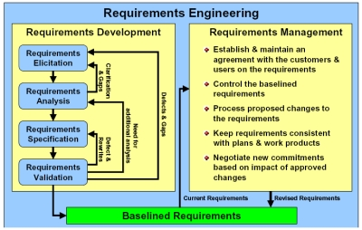
http://www.raamstijn.nl/eenblogjeom/index.php/requirements/198-requirements-engineering

Slide 5
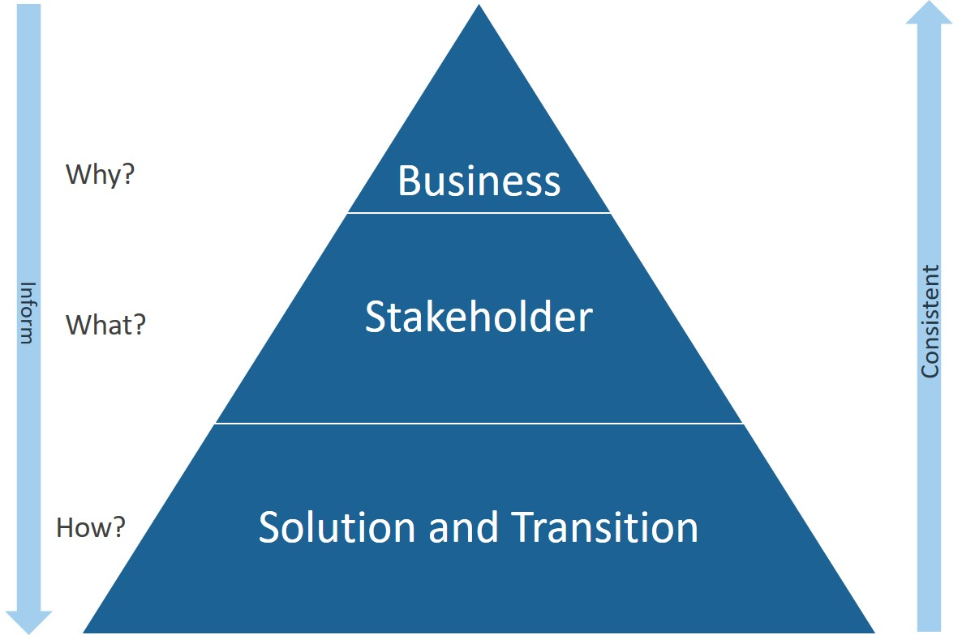
Level of Requirements

Slide 6
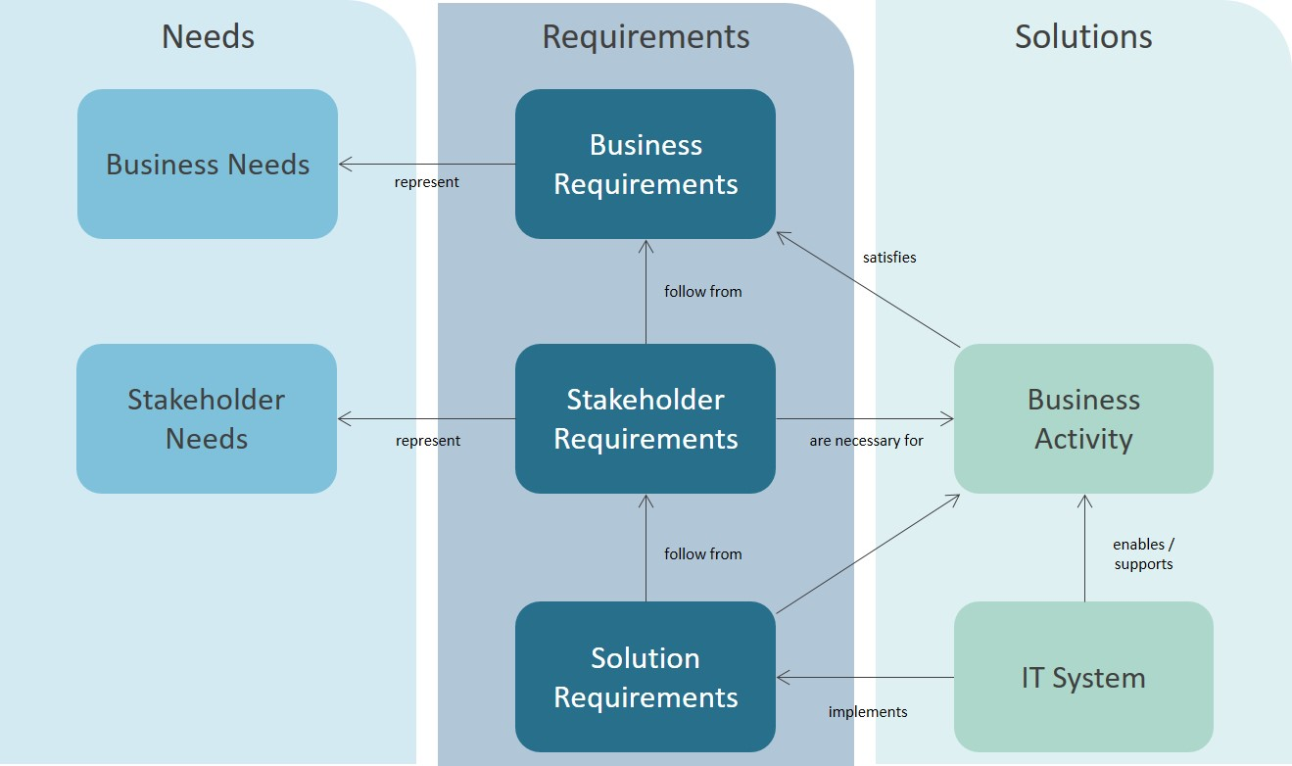
Need vs Requirements

Slide 7
Unique ID!! For each requirement
Business Requirements
Business Requirement → “WHY”
Why the organization undertakes the project, needs the system?
Comes from Business Analysis, Business Case or Project vision
The PROBLEM to solve must be reflected (research question?)
B01 The CFO wants to have 90% of the purchase invoices paid automatically to reduce the workload for the AP department
B02 The CFO wants to have up-to-date visualized financial information in order to be able to evaluate the financial obligations of the AP department
Notes:
Requirement →”WHY”
Why the organisation undertakes the project, needs the system
Comes from Business Analysis, Business Case or Project vision
The PROBLEM to solve must be reflected (research question?)

Slide 8
Unique ID!! For each requirement
User Requirements or Stakeholders Requirements
User Requirements → “WHAT”
What the user will be able to do with the system (goals/tasks)
One functionality per requirement
Related to the Business Requirements
Difficult, because the user self does not always know what the system/software should do (an important role for Business Analysts)
UR01 The Accounts Payable clerk will be able to see the automatically paid purchase invoices
UR02 The AP clerk will be able to authorize payment for purchase invoices that are not processed automatically
UR03 The Financial Director will be able to slice in months and years on the dashboard graphics
Notes:
User Requirement → “WHAT”
What the user will be able to do with the system (goals/tasks)
One functionality per requirement
Related to the Business Requirements
Difficult, because the user self not always knows what the system/software should do (important role for Business Analyst)

Slide 9
Unique ID!! For each requirement
System Requirements
(or Solution Requirements)
System (Functional/Non-function) Requirement → “HOW”
Describes what the system shall do (must/should/may), and
what the developer should build?
One functionality per requirement
Non-functional requirements must be measurable (SMART)
Related to the Business Requirements
SR01 The system shall compare the ordered number of products on the purchase order, with the delivered quantities and the invoiced number of products on the related invoice
SR02 The system shall flag purchase invoices as ‘ready for payment’ after authorization
SR03 The system shall only pay purchase invoice when they have a purchase order number
SR04 The system shall generate a visual at least within 5 seconds
Notes:
System (Functional/Non-function) Requirement → “HOW”
Describes what the system shall do (must/should/may), and what the developer should build
One functionality per requirement
Non-functional requirements must be measurable (SMART)
Related to the Business Requirements

Slide 10
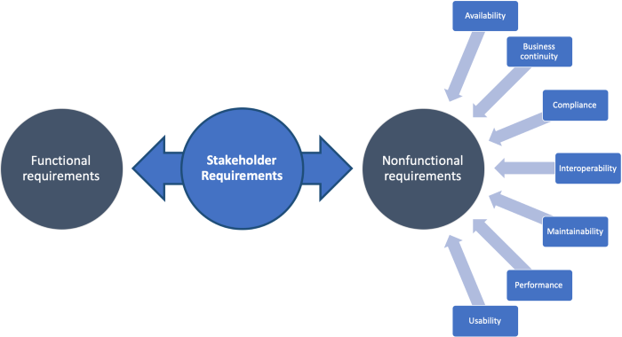
Functional vs Non Functional
User Requirements

Slide 11
Functional vs Non-Functional
 | Functional Requirement | Non-Functional Requirement
Requirement | It is mandatory | It is non-mandatory
Capturing type | It is captured in use case | It is captured as a quality attribute
End-result | Product feature | Product properties
Capturing | Easy to capture | Hard to capture
Objective | Helps you verify the functionality of the software | Helps you to verify the performance of the software
Area of focus | Focus on user requirement | Concentrates on the user's expectation.
Documentation | Describe what the product does | Describes how the product works
Type of Testing | Functional Testing like System, Integration, End to End, API testing, etc. | Non-Functional Testing like Performance, Stress, Usability, Security testing, etc.
Test Execution | Test Execution is done before non-functional testing | After the functional testing
Product Info | Product Feature | Product Properties

Slide 12
Requirement Analysis
Quality of Requirements
Notes:
.

Slide 13
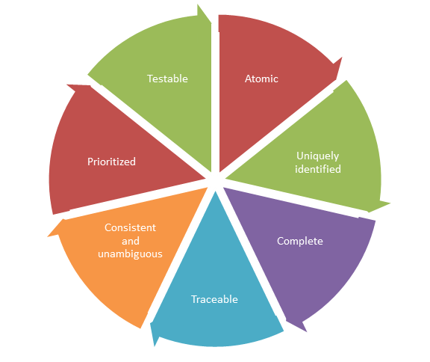
Quality of Requirements
7 quality categories
Using an educational software system where a student can register for different courses, as an example

Slide 14
Atomic
Bad Requirement Good Requirement
Students will be able to enroll in undergraduate and postgraduate courses
Students will be able to enroll to undergraduate courses
Students will be able to enroll to post-graduate course
Each requirement should address one specific functionality or behavior. Avoid combining multiple functionalities into one requirement.
The bad requirement is not atomic because it talks about two different entities undergraduate and post-graduate courses.

Slide 15
Uniquely identified and Traceable
Bad Requirement Good Requirement
1- Students will be able to enroll to undergraduate courses
1- Students will be able to enroll to post-graduate courses
UR1 Students will be able to enroll to undergraduate courses
UR2 Students will be able to enroll to post-graduate courses
Provide unique ID’s for your requirements, so that you can refer to them easily. So, we should be able to take every business requirements and map it to the corresponding one or more user- and system requirements!
For the bad requirements, you would not know which requirement is meant when referring to ID 1

Slide 16
Complete
Bad Requirement Good Requirement
A professor user will log into the system by providing his username, password, and other relevant information
A professor user will log into the system by providing his username, password and department code
Each and every requirement should be complete.
The bad requirement says, "and other relevant information". Here the other relevant information is not clear

Slide 17
Consistent and unambiguous
Bad Requirement Good Requirement
A student will have either undergraduate courses or post-graduate courses but not both.
Some courses will be open to both under-graduate and post-graduate
A student will have either undergraduate or post-graduate but not both
For each requirement, you should be consistent and not contradict with other requirements
The problem here is that the first requirement conflicts with the second requirement and it tells that some courses will open to both post-graduate and under-graduate.

Slide 18
Prioritised
Bad Requirement Good Requirement
Registered student – Priority 1
Maintain User Info – Priority 1
Enroll courses – Priority 1
View Report Card – Priority 1
Register Student – Must have
Maintain User Info – Should have
Enroll courses – Must have
View Report Card – Could have
Every requirement must be prioritized, so the team has guideline which requirement it is able to implement first and which can be done later.
The bad requirement is not prioritized, as every has the same priority

Slide 19
Testable
Bad Requirement Good Requirement
Each page of the system will load in an acceptable time-frame
Register student and enroll courses pages of the system will load within 5 seconds
Each requirement should be testable and therefore defined SMART
The bad requirement is "each page....in an acceptable time frame". Each page means that there can be many pages, which going to blow up the testing efforts. Also what is an acceptable time frame? Acceptable to whom?

Slide 20
Recap
Requirements analysis
Learning Outcomes
Learning outcome 4: Professional standard
Learning outcome 5: Personal Leadership

Slide 21

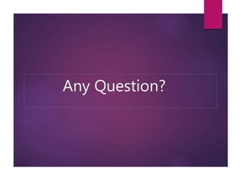
Thank you!
By Raja Gorentla

